Slide 1
Analytical Study of Operational Efficiency and Financial Optimization in a Dental Clinic
Name: Manoj Prathapa
Roll number: 23f1001473

Slide 2
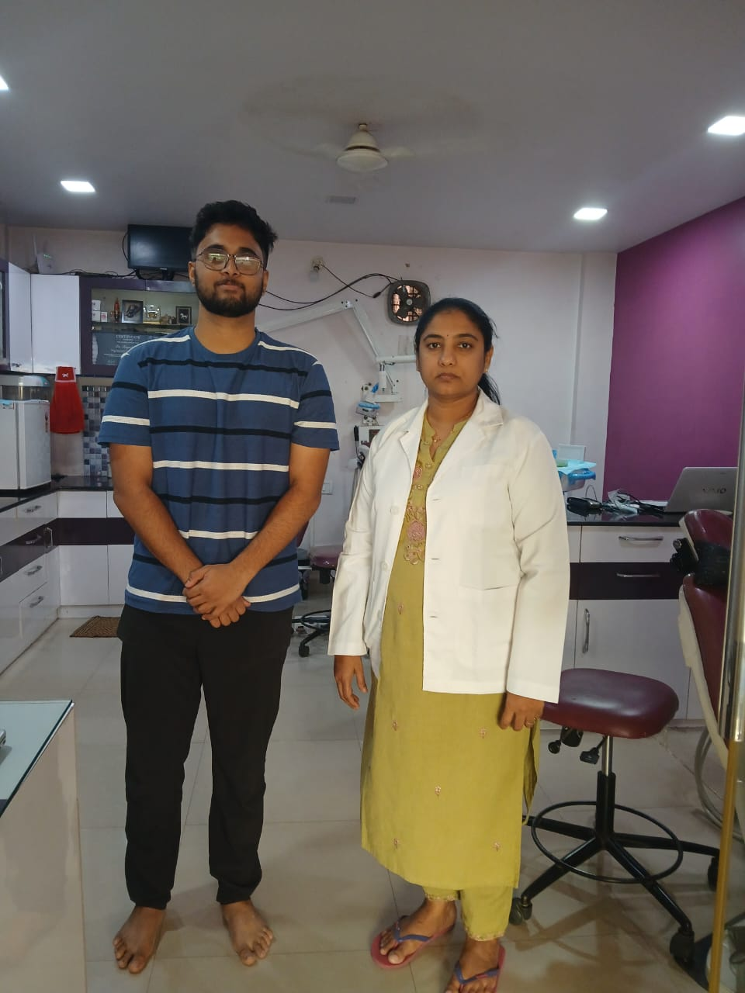
Organizational Background
Aadya Family Dental Center, owned and operated by Dr. Ragini Kiran Meka, located in Bangalore, Karnataka, it has been providing affordable dental care for over 11 years. Established with a vision to make professional dental services accessible to all, the clinic has grown into a well-recognized name in the community. Operating on a B2C business model, Aadya Family Dental Center offers a diverse range of services, from preventive check-ups to advanced restorative treatments, ensuring comprehensive oral healthcare for its patients.

Slide 3
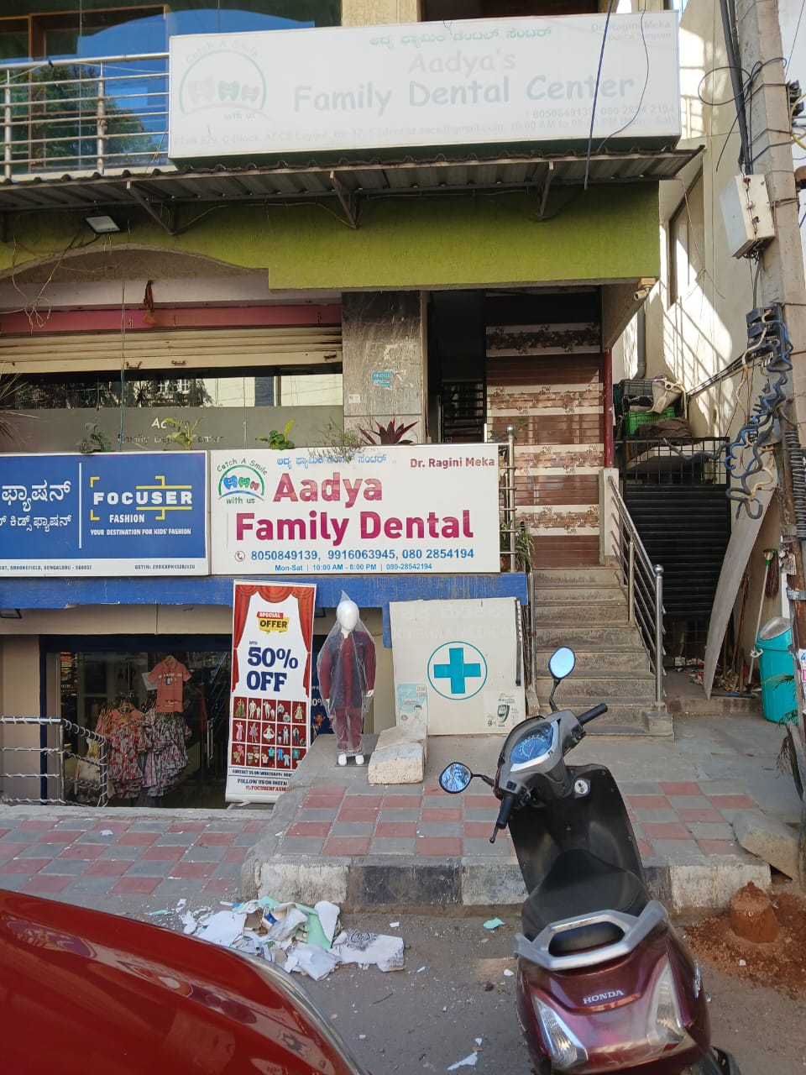
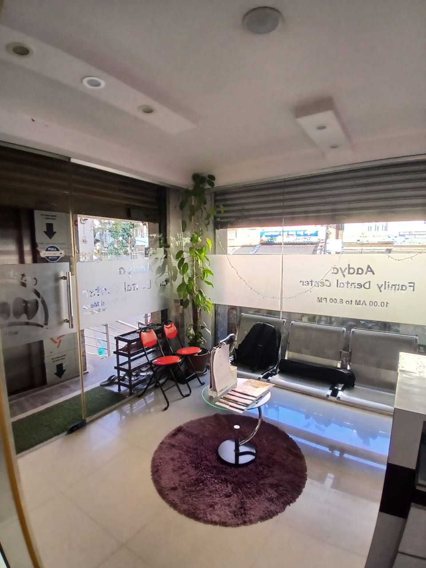
Problem statements
Inefficient Appointment Scheduling:Patients experience long waiting times and congested peak hours leading to revenue loss.
Revenue Leakages & Outstanding Payments:Payment and revenue management depend too much on uncollected payments and discounting practices which threaten financial stability.
Lack of Data-Driven Pricing & Marketing Strategies :Working out high-revenue procedures and effective marketing and pricing strategies of the owner will maximize both revenues and profits.

Slide 4
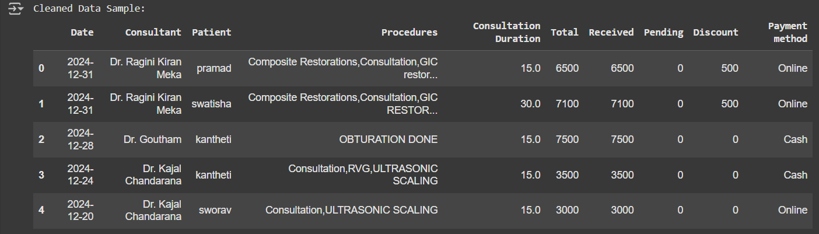
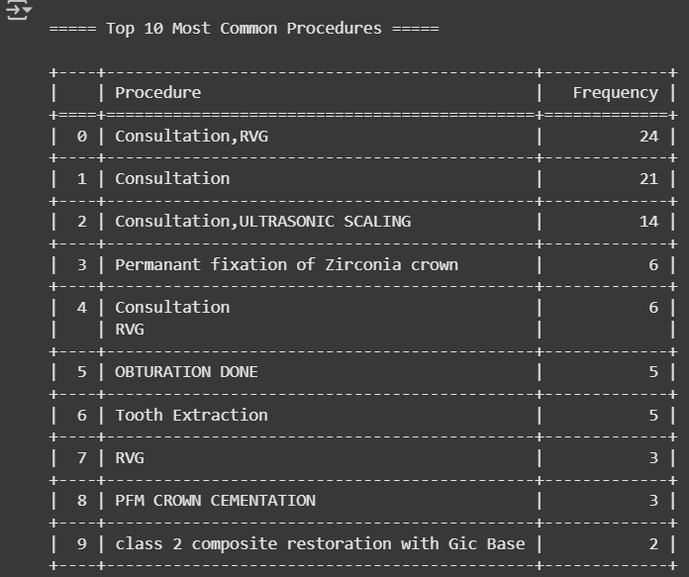
Data driven approach
collected data for the past 7 months over a time period form 1st June,2024 to 31st December 2024.
Data collected included:
Appointment Data: Patient names, time slots, consultation durations
Financial Data: Revenue, discounts, outstanding payments
Procedure Data: Most & least profitable treatments.
Compiled all three into a single excel sheet to make it easier to work on and did basic EDA on the data go gather insights.

Slide 5
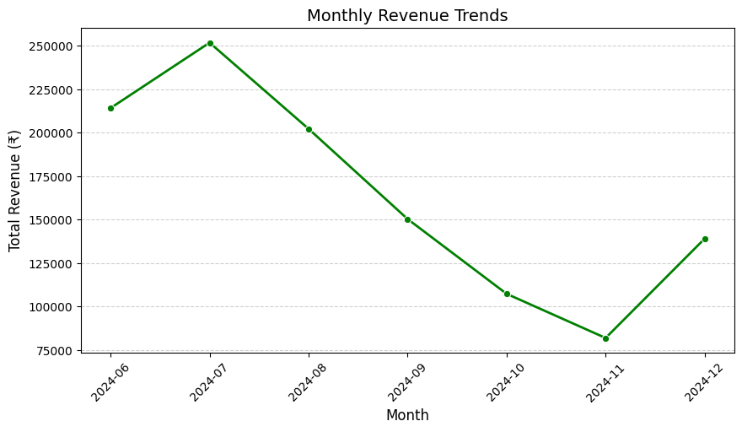
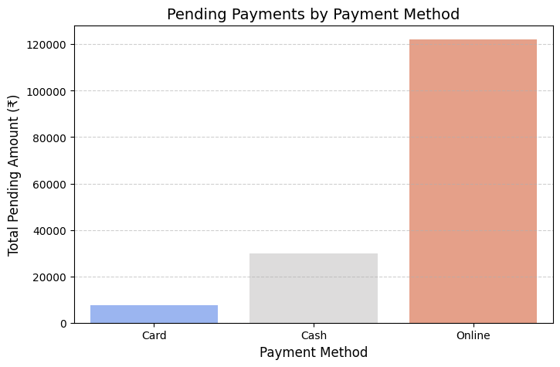
General analysis
Line graph to show the monthly revenue trends we can see a peak in revenue but it is non sustaining.
The bar chart for the type of transaction where pending payments occur shows us that incentivizing people to pay by cash would reduce the pending payment situation.

Slide 6
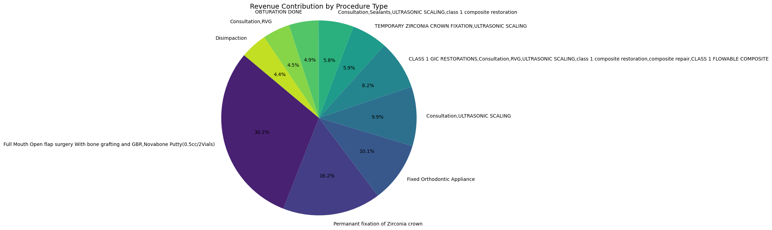
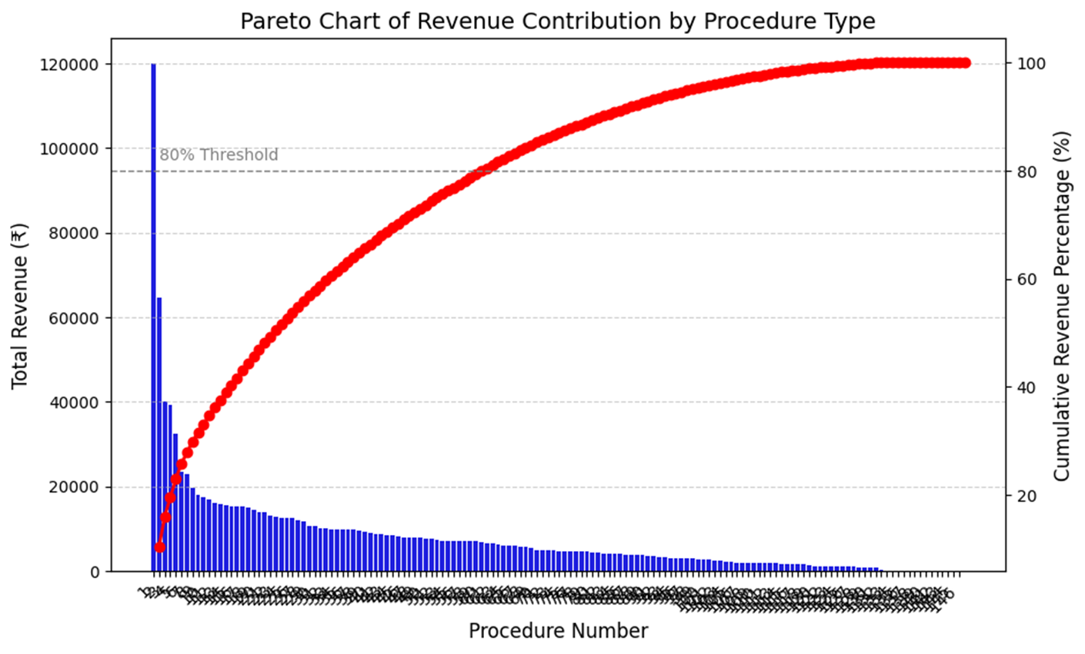
Most & Least Profitable Procedures
Pie chart shows us the revenue contribution of each procedure.
The most frequent procedures at Aadya Family Dental Center are:
Consultation and X-Ray (RVG) have 24 cases
General Consultation has 21 cases
Ultrasonic Scaling and (Teeth Cleaning) has 14 cases
Zirconia Crown Fixation has 6 cases
Tooth Extraction has 5 cases
Though they are high in number, routine consultations contribute less percentage to total revenue besides high-value procedures like crowns and implants.

Slide 7
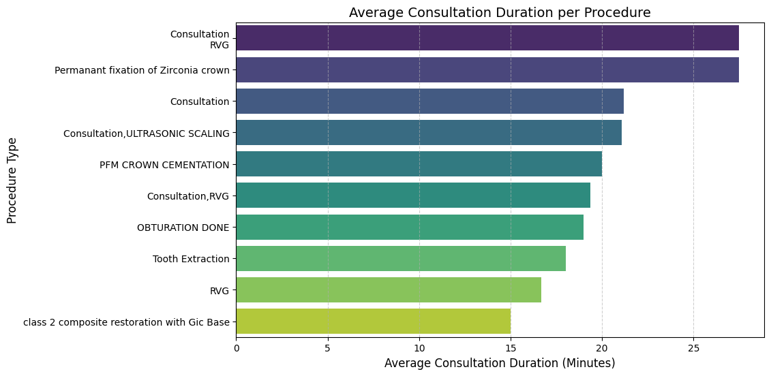
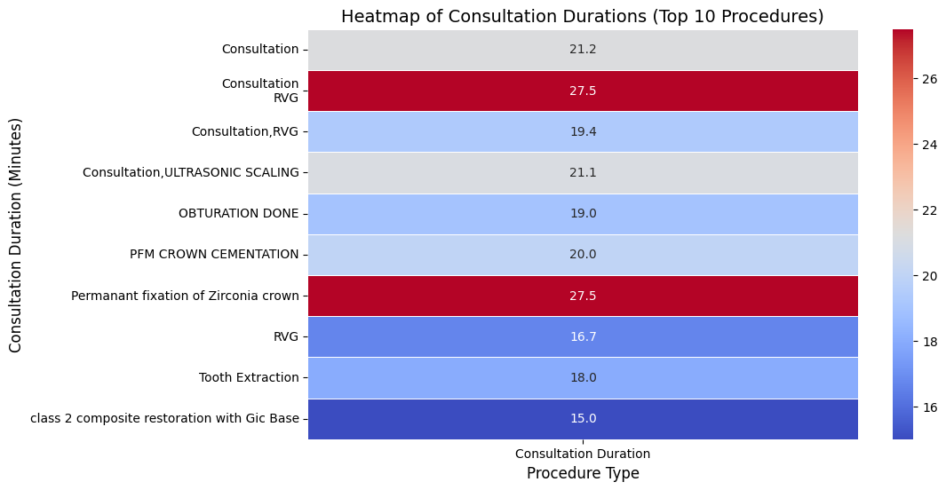
Appointment Scheduling Analysis
Peak congestion from 4 PM – 8 PM leads to long patient queues.
Morning slots (8 AM – 12 PM) remain underutilized, causing revenue inefficiencies.
Frequent patients book longer slots, making it hard for new patients to get timely appointments.
average consultation time is approximately 22 minutes, with variations depending on the complexity of the procedure.

Slide 8
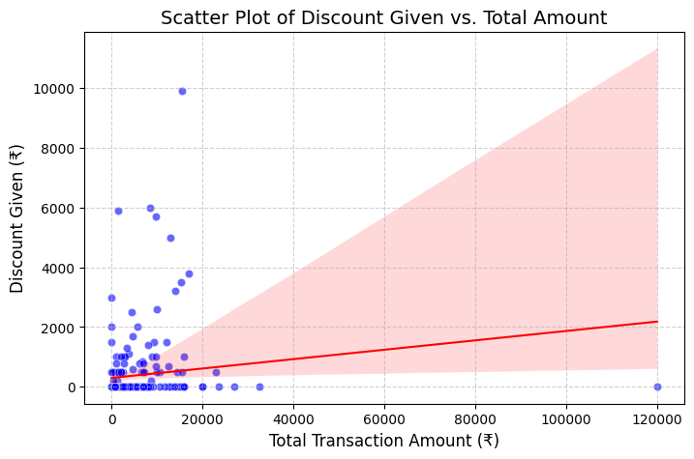
Key findings
The most common high-paying procedures over the last six months include Zirconium Crowns, Fixed Orthodontic Appliances, and Full Mouth Surgery.
A decline in revenue was observed from mid-February to March, primarily due to seasonal variations in patient visits and underutilization of high-value procedures.
The clinic loses approximately 15% of potential revenue due to discounts and unpaid dues.
Revenue per patient varies significantly, with routine consultations generating ₹500–₹800 per visit, while advanced procedures contribute up to ₹1,20,000 per case.
A majority of patients opting for installment-based payments delay settlements beyond 30 days, leading to cash flow inconsistencies and delayed reinvestment opportunities.

Slide 9
recommendations
Optimize high-value procedure scheduling by prioritizing peak hours for treatments having higher revenue cost to maximize revenue while reducing patient backlog.
Implement dynamic pricing strategies for high-value procedures, introducing discounts for cash payments and morning slots to increase utilization and maintain a steady revenue flow.
Strengthen payment collection processes by enforcing automated reminders for outstanding dues
Enhance revenue per patient by bundling routine consultations with profitable treatments, offering package deals that encourage higher spending per visit.
Introduce loyalty rewards for better customer retention.

Slide 10
Thank you

